Slide 1
Breast Cancer Dataset Classification

Slide 2
Contents
Experimental Design
Dataset Overview
Data Preprocessing
Selection of classification models
Performance of each classification models
Comparative performance of the 3 chosen models
Discussion and future work

Slide 3
Experimental Design
Chosen Dataset: breast-cancer
Purpose of the Analysis: This analysis evaluates the performance of three machine learning classifiers in predicting breast cancer recurrence, using clinical and diagnostic data. The goal is to determine the most effective model for accurate prediction and enhance clinical decision-making.
Dataset Overview
Size, feature, target variable and class distribution
Data Preprocessing
Handling missing values, Categorical Variable Encoding, Feature Scaling, Distribution Balancing with Oversampling
Implementing Classification Models
DT Classifier, Logistic Regression and MLP classifier
Model Evaluation
Cross-validation, accuracy, precision, confusion matrix

Slide 4
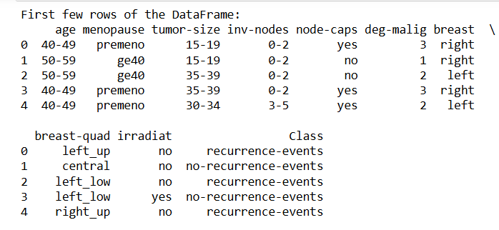
Dataset Overview
Size
Features
286 instances
9 input features
+
1 target variable
Target
Class Distribution
Class (no-recurrence events, recurrence-events)
no-recurrence events : 201 (70.0%)
recurrence-events : 85 (30.0%)

Slide 5
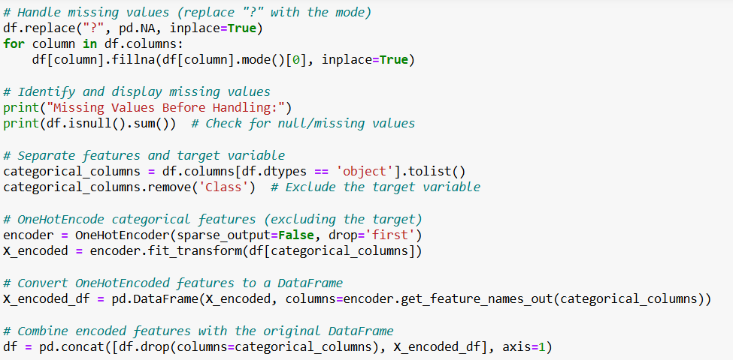
Data Preprocessing
Handling Missing Values
1
9 missing values in the dataset, denoted by “?”. Replaced them with mode
2
Categorical Variable Encoding
Encoded categorical features into numerical format using OneHotEncoding (e.g., for age, timor-size etc)
Feature Scaling
3
Applied StandardScaler to normalize features. Ensures all features contribute equally to the model.
4
Distribution Balancing with Oversampling
Addressed the class imbalance (initially 70-30 distribution) by oversampling the minority class to achieve a 50-50 balance
Discretization is not needed, as the features are already categorized into discrete bins or are categorical by nature.

Slide 6
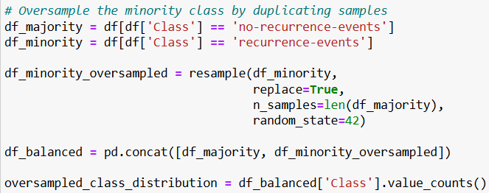
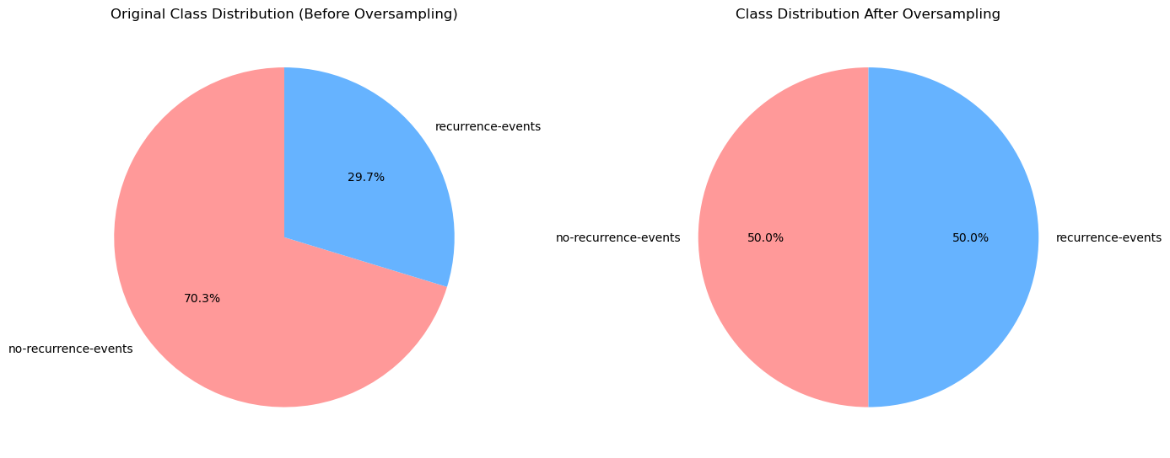
Oversample the minority class by duplicating samples

Slide 7
Selection of Classification Methods (scikit-learn)
Classification Methods | Reason for selection
DecisionTreeClassifier (Decision Tree) | Interpretability: Easy to understand and visualize, making it ideal for explaining model decisions. Non-linear Relationships: Can capture complex, non-linear decision boundaries. Versatility: Handles both categorical and numerical data without feature scaling. Robust to Missing Data: Can deal with missing values by learning from available data.
LogisticRegression (Functions) | Simplicity & Efficiency: Simple, computationally efficient, and often used as a baseline. Probabilistic Output: Provides probabilities, helping with decision thresholds. Interpretability: Easy to understand how features contribute to predictions. Less Prone to Overfitting: Works well with simpler datasets and generalizes well with proper regularization.
MLPClassifier (Neural Network) | Powerful for Complex Patterns: Excels at learning intricate, non-linear relationships. High Flexibility: Adapts well to various data types and automatically learns feature interactions. Better Performance on Large Datasets: Suitable for large datasets where other models might underperform. Non-linear Activation Functions: Creates highly flexible decision boundaries for better prediction accuracy.

Slide 8
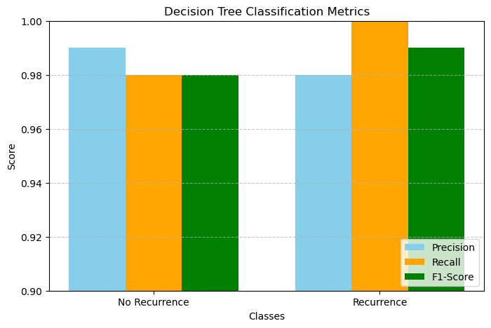
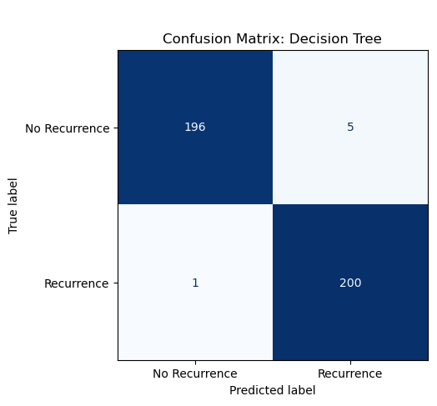
Model Performances: Decision Tree Classification Report and Confusion Matrix
Overall Accuracy (entire dataset): 0.985

Slide 9
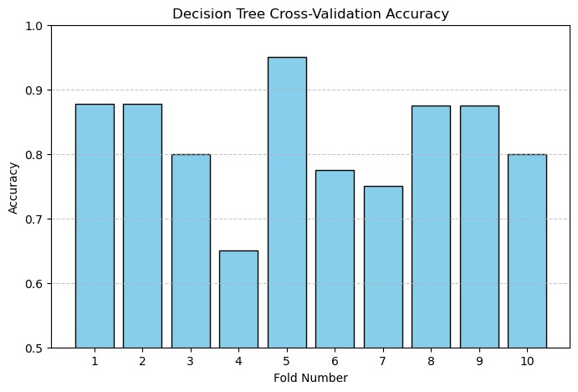
Model Performances: Decision Tree Cross-Validation Results
Key Information:
Mean Accuracy: 0.8231
Standard Deviation: 0.0814

Slide 10
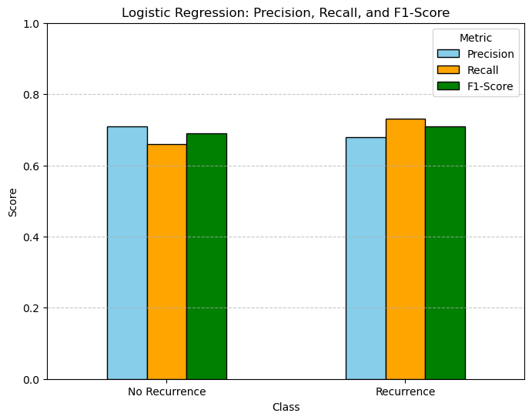
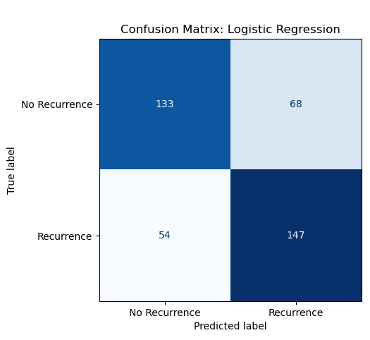
Model Performances: Logistic Regression Classification Report and Confusion Matrix
Overall Accuracy (entire dataset): 0.696

Slide 11
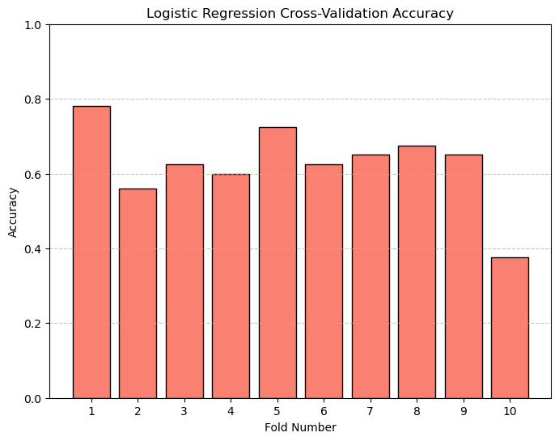
Model Performances: Logistic Regression Cross-Validation Results
Key Information:
Mean Accuracy: 0.6266
Standard Deviation: 0.1025

Slide 12
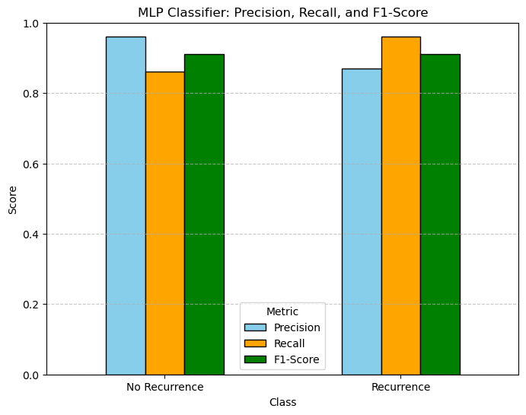

Model Performances: MLP Classifier Classification Report and Confusion Matrix
Overall Accuracy (entire dataset): 0.91

Slide 13
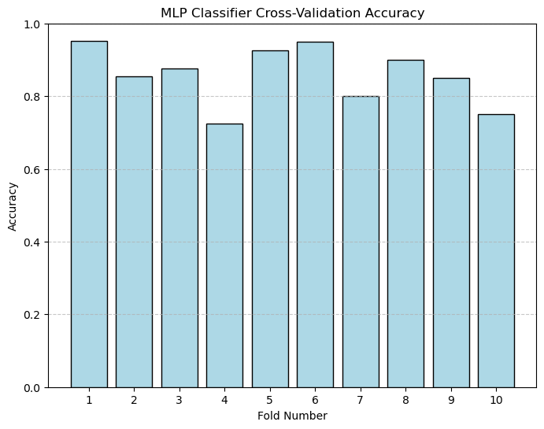
Model Performances: MLP Classifier Cross-Validation Results
Key Information:
Mean Accuracy: 0.8580
Standard Deviation: 0.0752

Slide 14
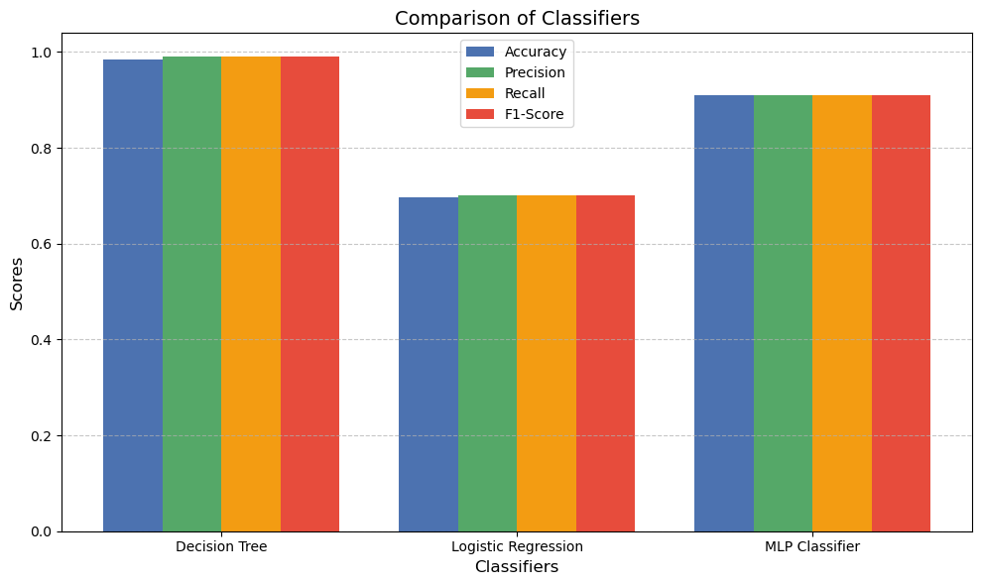
Model Performance Comparison
Decision Tree
1
The Decision Tree has the highest accuracy (98.5%) and performs well across all metrics.
MLP Classifier
2
The Neural Network performs almost as well in accuracy (91%), precision, recall, and F1-score.
Logistic Regression
3
The Logistic Regression classifier has the lowest performance, especially in terms of accuracy.

Slide 15
Conclusion & Future Work
Key Takeaways:
The Decision Tree classifier is the most effective for predicting both classes of events, delivering high accuracy with minimal errors.
Neural Networks, while accurate, present a higher risk of false positives, which could lead to unnecessary treatments.
Logistic Regression performed the least effectively, with lower accuracy and precision.
Overall, the Decision Tree classifier is recommended for its reliability in balancing performance and practical application in medical settings.
Future Work:
Future improvements could focus on fine-tuning the Neural Network for better performance or testing other classifiers.

Slide 16
Thank you

